Slide 1
Bootstrap Pagination & Pager
廖向德

Slide 2
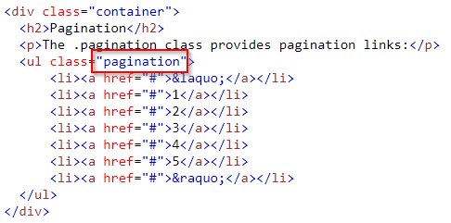
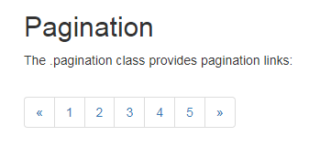
Basic Pagination
To create a basic pagination, add the .pagination class to an <ul> element
https://www.w3schools.com/code/tryit.asp?filename=FKK4JT4O9JU6
Notes:
<!DOCTYPE html>
<html lang="en">
<head>
<title>Bootstrap Example</title>
<meta charset="utf-8">
<meta name="viewport" content="width=device-width, initial-scale=1">
<link rel="stylesheet" href="https://maxcdn.bootstrapcdn.com/bootstrap/3.3.7/css/bootstrap.min.css">
<script src="https://ajax.googleapis.com/ajax/libs/jquery/3.2.1/jquery.min.js"></script>
<script src="https://maxcdn.bootstrapcdn.com/bootstrap/3.3.7/js/bootstrap.min.js"></script>
</head>
<body>
<div class="container">
<h2>Pagination</h2>
<p>The .pagination class provides pagination links:</p>
<ul class="pagination">
<li><a href="#">&laquo;</a></li>
<li><a href="#">1</a></li>
<li><a href="#">2</a></li>
<li><a href="#">3</a></li>
<li><a href="#">4</a></li>
<li><a href="#">5</a></li>
<li><a href="#">&raquo;</a></li>
</ul>
</div>
</body>
</html>

Slide 3
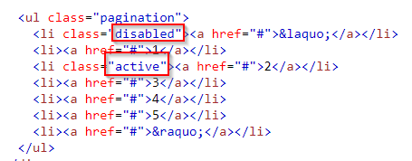
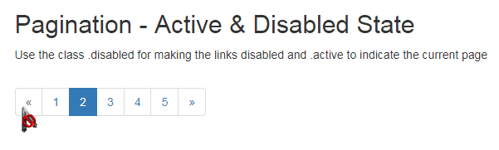
Active & Disabled State
Use the class .disabled for making the links disabled and .active to indicate the current page.
Notes:
<!DOCTYPE html>
<html lang="en">
<head>
<title>Bootstrap Example</title>
<meta charset="utf-8">
<meta name="viewport" content="width=device-width, initial-scale=1">
<link rel="stylesheet" href="https://maxcdn.bootstrapcdn.com/bootstrap/3.3.7/css/bootstrap.min.css">
<script src="https://ajax.googleapis.com/ajax/libs/jquery/3.2.1/jquery.min.js"></script>
<script src="https://maxcdn.bootstrapcdn.com/bootstrap/3.3.7/js/bootstrap.min.js"></script>
</head>
<body>
<div class="container">
<h2>Pagination - Active & Disabled State</h2>
<p>Use the class .disabled for making the links disabled and .active to indicate the current page</p>
<ul class="pagination">
<li class="disabled"><a href="#">&laquo;</a></li>
<li><a href="#">1</a></li>
<li class="active"><a href="#">2</a></li>
<li><a href="#">3</a></li>
<li><a href="#">4</a></li>
<li><a href="#">5</a></li>
<li><a href="#">&raquo;</a></li>
</ul>
</div>
</body>
</html>

Slide 4
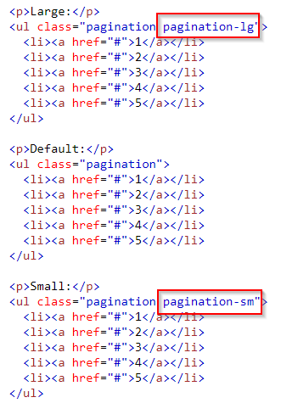
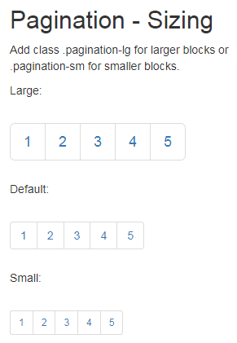
Pagination Sizing
Notes:
<!DOCTYPE html>
<html lang="en">
<head>
<title>Bootstrap Example</title>
<meta charset="utf-8">
<meta name="viewport" content="width=device-width, initial-scale=1">
<link rel="stylesheet" href="https://maxcdn.bootstrapcdn.com/bootstrap/3.3.7/css/bootstrap.min.css">
<script src="https://ajax.googleapis.com/ajax/libs/jquery/3.2.1/jquery.min.js"></script>
<script src="https://maxcdn.bootstrapcdn.com/bootstrap/3.3.7/js/bootstrap.min.js"></script>
</head>
<body>
<div class="container">
<h2>Pagination - Sizing</h2>
<p>Add class .pagination-lg for larger blocks or .pagination-sm for smaller blocks.</p>
<p>Large:</p>
<ul class="pagination pagination-lg">
<li><a href="#">1</a></li>
<li><a href="#">2</a></li>
<li><a href="#">3</a></li>
<li><a href="#">4</a></li>
<li><a href="#">5</a></li>
</ul>
<p>Default:</p>
<ul class="pagination">
<li><a href="#">1</a></li>
<li><a href="#">2</a></li>
<li><a href="#">3</a></li>
<li><a href="#">4</a></li>
<li><a href="#">5</a></li>
</ul>
<p>Small:</p>
<ul class="pagination pagination-sm">
<li><a href="#">1</a></li>
<li><a href="#">2</a></li>
<li><a href="#">3</a></li>
<li><a href="#">4</a></li>
<li><a href="#">5</a></li>
</ul>
</div>
</body>
</html>

Slide 5
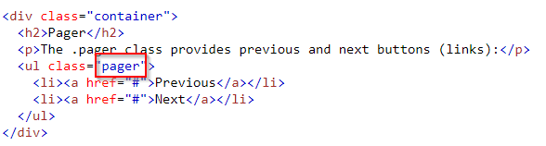

Pager
Pager provides previous and next buttons (links).
To create previous/next buttons, add the .pager class to an <ul> element
Notes:
<!DOCTYPE html>
<html lang="en">
<head>
<title>Bootstrap Example</title>
<meta charset="utf-8">
<meta name="viewport" content="width=device-width, initial-scale=1">
<link rel="stylesheet" href="https://maxcdn.bootstrapcdn.com/bootstrap/3.3.7/css/bootstrap.min.css">
<script src="https://ajax.googleapis.com/ajax/libs/jquery/3.2.1/jquery.min.js"></script>
<script src="https://maxcdn.bootstrapcdn.com/bootstrap/3.3.7/js/bootstrap.min.js"></script>
</head>
<body>
<div class="container">
<h2>Pager</h2>
<p>The .pager class provides previous and next buttons (links):</p>
<ul class="pager">
<li><a href="#">Previous</a></li>
<li><a href="#">Next</a></li>
</ul>
</div>
</body>
</html>

Slide 6
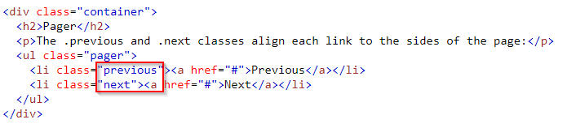
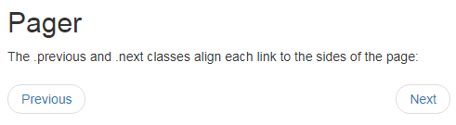
Alignment of Pager (1/2)
By default pager are aligned horizontally center, but you can align previous link to left and next link right using the class .previous and .next respectively
Notes:
<!DOCTYPE html>
<html lang="en">
<head>
<title>Bootstrap Example</title>
<meta charset="utf-8">
<meta name="viewport" content="width=device-width, initial-scale=1">
<link rel="stylesheet" href="https://maxcdn.bootstrapcdn.com/bootstrap/3.3.7/css/bootstrap.min.css">
<script src="https://ajax.googleapis.com/ajax/libs/jquery/3.2.1/jquery.min.js"></script>
<script src="https://maxcdn.bootstrapcdn.com/bootstrap/3.3.7/js/bootstrap.min.js"></script>
</head>
<body>
<div class="container">
<h2>Pager</h2>
<p>The .previous and .next classes align each link to the sides of the page:</p>
<ul class="pager">
<li class="previous"><a href="#">Previous</a></li>
<li class="next"><a href="#">Next</a></li>
</ul>
</div>
</body>
</html>

Slide 7
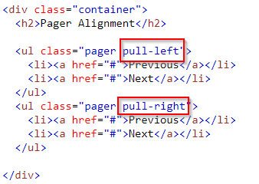
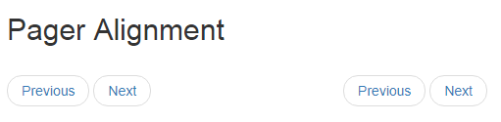
Alignment of Pager (2/2)
What if you want to align right or left instead of default align center?
Notes:
<!DOCTYPE html>
<html lang="en">
<head>
<title>Bootstrap Example</title>
<meta charset="utf-8">
<meta name="viewport" content="width=device-width, initial-scale=1">
<link rel="stylesheet" href="https://maxcdn.bootstrapcdn.com/bootstrap/3.3.7/css/bootstrap.min.css">
<script src="https://ajax.googleapis.com/ajax/libs/jquery/3.2.1/jquery.min.js"></script>
<script src="https://maxcdn.bootstrapcdn.com/bootstrap/3.3.7/js/bootstrap.min.js"></script>
</head>
<body>
<div class="container">
<h2>Pager Alignment</h2>
<ul class="pager pull-left">
<li><a href="#">Previous</a></li>
<li><a href="#">Next</a></li>
</ul>
<ul class="pager pull-right">
<li><a href="#">Previous</a></li>
<li><a href="#">Next</a></li>
</ul>
</div>
</body>
</html>

Slide 8
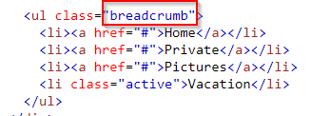
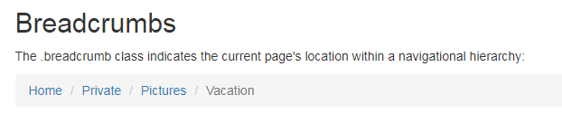
Breadcrumbs
The .breadcrumb class indicates the current page's location within a navigational hierarchy
https://www.w3schools.com/bootstrap/tryit.asp?filename=trybs_breadcrumbs&stacked=h
Notes:
<!DOCTYPE html>
<html>
<head>
<meta name="viewport" content="width=device-width, initial-scale=1">
<link rel="stylesheet" href="https://maxcdn.bootstrapcdn.com/bootstrap/3.3.7/css/bootstrap.min.css">
<script src="https://ajax.googleapis.com/ajax/libs/jquery/3.2.1/jquery.min.js"></script>
<script src="https://maxcdn.bootstrapcdn.com/bootstrap/3.3.7/js/bootstrap.min.js"></script>
</head>
<body>
<div class="container">
<h2>Breadcrumbs</h2>
<p>The .breadcrumb class indicates the current page's location within a navigational hierarchy:</p>
<ul class="breadcrumb">
<li><a href="#">Home</a></li>
<li><a href="#">Private</a></li>
<li><a href="#">Pictures</a></li>
<li class="active">Vacation</li>
</ul>
</div>
</body>
</html>

